Slide 1
EMAIL-SIG
Service Update
November 17, 2009
ISC Networking & Telecommunications

Slide 2
Format
Exchange
Forward-Only
SMTP-Relay
PennNet Mailing Lists
Zimbra

Slide 3

Exchange

Slide 4
Agenda
Overview of Service
Availability Report
Rates
Roadmap
Q&A

Slide 5
Overview
In production since July 2007
10 Windows servers in 3 campus data centers
2 TB of mailbox storage
Data replicated in Levy and Nichols campus data centers

Slide 6
Overview
Over 3,200 accounts
About 325 BlackBerry handhelds (up 18%)
About 413 ActiveSync handhelds (up 20%)
More than 627 users purchased higher quota (down 30%)
Notes:
Default quota increased from 250MB to 500MB in August.

Slide 7
Service Review
Availability for FY10 YTD
Incidents
Maintenance
Remedy Cases
Accomplishments
Rates

Slide 8
Availability
Target: 99.5% (43 hours, 48 minutes)
Exchange: 99.95% (1 hour, 26 minutes, 24 seconds)
BlackBerry: 100%
Averaged across multiple servers/services

Slide 9
Incidents
July 27, 12:00-12:30: Storage group unmounts during regular data restore
September: Specific user connectivity problems following iPhone 3.1 updates

Slide 10
Monitoring
Nagios polls services, reports availability
Logcaster examines event logs
Spectrum pings, sends alarms
Oncall service 24x7x365

Slide 11
Maintenance
June 29, 10:00-11:00PM - EAM and EAS bug fixes
July 30, 6:00-6:30AM - EAM and EAS base quota Increase changes
August 27 - Rollup 9
October 1, 5:00-6:00AM - EAM and EAS CoSign, timeout, and auto-accept
Periodic targeted user moves between SGs

Slide 12
Remedy Cases
SLA: 24 hour response
Over Sept/Oct, 63 cases; (~30/month avg. previous period
Notes:
Conversion to Remedy 7 on August 10, 2009, made some statistics more difficult to gather for this period.

Slide 13
Accomplishments
Significant changes to Account Management and Account Services
Better understanding of complexity of mobile device support
Corrected IMAP access issue (via Rollup 9)
Integration with ACD and campus call centers

Slide 14
Rates
No rate changes since service introduction in July 2007
Current: Exchange @ $7.50/month; BlackBerry @$13.50/month
Change: Exchange charge from $7.50-$9.00/month possible for FY11
Change: BlackBerry charge from $13.50-$19.50/month possible for FY11
Additional storage: $1.25/250MB/month (unchanged)
Quota: 500MB; Auto-quota up to 2GB; Max quota up to 5 GB

Slide 15
Exchange Roadmap
Short-term (0-3 months)
Medium-term (4-12 months)
Long-term (>1 year)

Slide 16
Short-term
iPhone security policy changes
Free/busy sharing with Wharton and Nursing
Exchange 2007 SP2
Notes:
Relative good luck testing another short-term issue, larger quotas, since our last report.
SP2 has significant auditing capability that will make troubleshooting easier.

Slide 17
Medium-term
Monitoring
Round-trip delay detection
Investigate mailbox level restores

Slide 18
Long-term
Exchange 2010
Off-campus DR
Contain costs

Slide 19
Q&A - Customers
What is the mobile platform of choice for your users? Any changes planned?
If we define a window for routine maintenance, would M-F 1-3AM and S-S 6-7AM work?
Do you have blackout periods when no changes should be made?
Who’s running SharePoint in production and what do you use it for?

Slide 20
Q&A – Your topics
Exchange 2010
Public Folders
BlackBerry rates
How to move data out of Outlook but still keep it accessible?
Notes:
2010 – Archiving and discovery (legal hold), mailbox resiliency, mobile email improvements (push Outlook mobile, nickname cache, f/b lookup), message tracking, Outlook web app

Slide 21
References
http://www.upenn.edu/computing/email/
http://www.upenn.edu/computing/email/exchange/sig-meetings/
http://prowiki.isc.upenn.edu/wiki/ISC_Zimbra_documentation
https://zimbra.upenn.edu/home/nt-dtime/Calendar?fmt=html

Slide 22
Forward-Only

Slide 23
Architecture
Leverages existing infrastructure for mail routing
Internal mail relays deliver to Exchange and Zimbra
MessageLabs

Slide 24
Forward-Only
GA on July 6, 2009
Over 1,500 accounts
Currently building tools for ISC to streamline account migrations
Change: Rates likely to drop from $1.50/month to $0.75/month in FY11
Notes:
This addressing for usernames in domains that are currently supported by Zimbra and Exchange and that don't have an account on either of those services.

Slide 25
SMTP-Relay
Use cases: printers, faxes, control systems that need to send email w/o user auth, or to external addresses
Separate service to avoid dependencies on Exchange and Zimbra
$10/IP address/month; No charge for mail within ISC service
Migrated to modern hardware on November 4
Currently used by 42 hosts

Slide 26
PennNet Mailing Lists
Migrated to modern hardware on November 4
Change: Updated to LISTSERV 15.5; UI improvements
Change: From current rate structure to $0.50/list/month in FY11
Notes:
If you use this service, please remember to subscribe to PennNet-Announce.

Slide 27
Zimbra

Slide 28
Overview
Production on July 26, 2008
10 Linux servers in 2 campus data centers
1.75 TB of mailbox storage
Data replicated in Levy and MODV campus data centers
About 12,800 accounts (down 6%)
111 with Mobile Sync enabled (up 95%)
Almost 200 users purchased higher quota

Slide 29
Service Review
Availability for FY10 YTD
Incidents
Maintenance
Remedy Cases
Accomplishments
Rates

Slide 30
Availability
Target: 99.9% (<9 hours)
Zimbra: 99.995 % (9 minutes, 43 seconds)
Averaged across multiple servers/services

Slide 31
Incidents
September 16 – IMAP service degraded due to sharp increase in simultaneous client connections
October 7, 10:00-11:50AM – Degraded performance required service restart
November 6 - Early deletion of expired student accounts in response to disk squeeze
November 11, 4:00-4:15AM – IMAP service degraded by DoS

Slide 32
Maintenance
July 30, 6:00-6:30 – ZAM and ZAS base quota increase changes
September 16, 11:00PM – Increase IMAP client threshold
November 14, 6:00-7:00AM – Add storage

Slide 33
Remedy Cases
SLA: 24 hour response
Over September/October, 52 cases; (~30/month avg. previous period)
Notes:
171 cases in previous period, December 2008 – May 2009

Slide 34
Accomplishments
Fall Feature Release: 5.0.15 upgrade, Zimlets, CoSign 3
Added more storage (August 23, November 14)
Gained BlackBerry service knowledge
Tested large quotas with success

Slide 35
Rates
No change to base price in four years
Current: Enhanced: $3.00/month; Basic: $3.50/month
Change: Zimbra increase up to $3.10/month and $3.60/month possible for FY11
Change: BlackBerry service to line up with Exchange at up to $19.50/month for FY11
Additional storage: $1.25/250MB/month (unchanged)
Quota: 500MB; Auto-quota up to 4GB; Max quota up to 10GB

Slide 36
Zimbra Roadmap
Short-term (0-3 months)
Medium-term (4-12 months)
Long-term (>1 year)

Slide 37
Short-term
BlackBerry: Manual provisioning works and we want pilot users
Winter Feature Release:
Zimbra 5.0.19
Scale out mailbox servers
Zimlet development
Refine monitoring of message queues, mail delays
Streamline migration of Zimbra accounts to Forward-Only
Notes:
WFR likely for January.

Slide 38
Medium-term
Zimbra 6.0 - better admin tools, social networking, better mobile UI, filter existing messages, read receipt, three-pane view, and more
Client distribution - iSync, ZCO, ZDC

Slide 39
Long-term
Zimbra 7.0
Integration with Jabber and Asterisk Enhanced Enterprise
Calendaring and Tasks
Lightweight project management (with Workspaces)
Integration with external services (Wave?)

Slide 40
Q&A - Customers
What is the mobile platform of choice for your users? Any changes planned?
If we define a window for routine maintenance, would M-F 1-3AM and S-S 6-7AM work?
Do you have blackout periods when no changes should be made?

Slide 41
Q&A – Your topics
iCal synching with Snow Leopard
Outlook access for shared calendars
Default text script for calendar events

Slide 42
References
http://www.upenn.edu/computing/email/
http://www.upenn.edu/computing/email/zimbra/sig-meetings/
http://prowiki.isc.upenn.edu/wiki/ISC_Zimbra_documentation
https://zimbra.upenn.edu/home/nt-dtime/Calendar?fmt=html

Slide 43
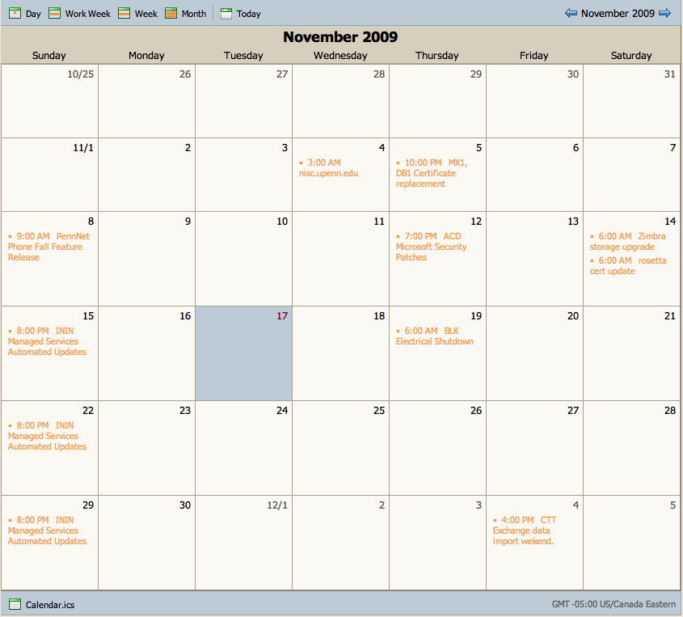
https://zimbra.upenn.edu/home/nt-dtime/Calendar?fmt=html
Notes:
For web display:
https://zimbra.upenn.edu/home/nt-dtime/Calendar?fmt=html
Or subscribe with your iCal compatible calendar client:
https://zimbra.upenn.edu/home/nt-dtime/Calendar

Slide 44
Thank You

