Slide 1
EMAIL-SIG
Service Update
June 15, 2010
ISC Networking & Telecommunications

Slide 2
Format
Forward-Only
SMTP-Relay
PennNet Mailing Lists
Exchange
Clients and Mobile Devices
Zimbra

Slide 3
Forward-Only
GA on July 6, 2009
Leverages existing infrastructure for mail routing
MessageLabs AV/AS
Over 2000 accounts (up 37% since Q2)
Internal tools to streamline Zimbra-to-FO account migrations
Rates drop from $1.50/month to $0.75/month in FY11
Notes:
This addressing for usernames in domains that are currently supported by Zimbra and Exchange and that don't have an account on either of those services.

Slide 4
SMTP-Relay
Use cases: printers, faxes, control systems that need to send email w/o user auth, or to external addresses
Separate service to avoid dependencies on Exchange and Zimbra
Migrated to modern hardware on November 4
Currently used by 48 hosts (up 14% since Q2)
$10/IP address/month; No charge for mail within ISC service

Slide 5
PennNet Mailing Lists
Migrated to LISTSERV 15.5 and modern hardware on November 4
Working toward LISTSERV 16 this summer; no UI changes
Rate structure changes to $0.50/list/month in FY11
Notes:
If you use this service, please remember to subscribe to PennNet-Announce.

Slide 6

Exchange

Slide 7
Agenda
Overview of Service
Availability Report
Rates
Roadmap
Q&A

Slide 8
Overview
In production since July 2007
10 Windows servers in 3 campus data centers
2 TB of mailbox storage
Data replicated in Levy and Nichols campus data centers
Vendor contracts: Microsoft, RIM, Dell

Slide 9
Overview
Over 3,500 accounts (up 18% over FY09)
About 365 BlackBerry handhelds (up 33% over FY09)
Almost 500 ActiveSync handhelds (up 44% over FY09)
Almost 900 users purchased higher quota (down, then up, equal to FY09)
Notes:
Default quota increased from 250MB to 500MB in August.

Slide 10
Service Review
Availability for FY10 YTD
Incidents
Maintenance
Remedy Cases
Accomplishments
Rates

Slide 11
Availability
Target: 99.5% (43 hours, 48 minutes)
Exchange: 99.93% (3 hours, 44 minutes)
BlackBerry: 100%
Averaged across multiple servers/services

Slide 12
Incidents
February 2, 2010, 7:00 - 9:00 a.m. - Mail delayed; inbound mail transport hangs
April 19, 2010 - Slowness; new release of backup software backs up active node rather than passive
May 10, 2010, 11:50 a.m. - 1:20 p.m. - OWA, CAS problems; early morning group policy change to software firewall propagates to Exchange cluster
May 21, 2010, 4:00 - 4:30 p.m. - Disk controller failure

Slide 13
Monitoring
Nagios polls services, reports availability
Logcaster examines event logs
Spectrum pings, sends alarms
Oncall service 24x7x365

Slide 14
Maintenance
December 7, 2009 - Moved iPhone pre-3G S devices to new security policy to allow 3.1.2+ upgrades
January 31, 2010, 12:00 - 3:00 a.m. - Rolling upgrade to Exchange 2007 SP2 RU 1
February 9, 2010, 5:00 p.m. - Installed critical security patches released by Microsoft
April 12, 2010, 6:00 p.m. - Rebuilt two SG indexes
May 8, 2010, 12:00 a.m. - Added more disk to accommodate indexes and backups

Slide 15
Maintenance
Periodic targeted user moves between SGs
As agreed, unadvertised, disruptive maintenance of up to 15 minutes may be performed:
Mon-Fri: 1am-3am
Sat-Sun: 6am-7am

Slide 16
Remedy Cases
SLA: 24 hour response
Over Dec-May, ~23 cases/month; (down 15% from FY09)
Notes:
Conversion to Remedy 7 on August 10, 2009, made some statistics more difficult to gather for this period.

Slide 17
Accomplishments
Clean up of iPhone security policy
Added storage
Exchange Risk Assessment and Health Check Program

Slide 18
Rates
First rate change since service introduction in July 2007
Exchange @ $7.75/month (from $7.50); BlackBerry @ $14/month (from $13.50)
Additional storage: $1.25/250MB/month (unchanged)
Default quota: 500MB; Auto-quota up to 2GB; Max quota up to 5 GB

Slide 19
Exchange Roadmap
Short-term (0-3 months)
Medium-term (4-12 months)
Long-term (>1 year)

Slide 20
Short-term
Test Outlook 2010 (PC) and 2011 (Mac)
Hub transport capacity
Keep pace with mobile device landscape

Slide 21
Medium-term
Investigate mailbox level restores
Test Exchange 2010

Slide 22
Long-term
Production Exchange 2010
R&D into off-campus DR
Contain costs
Look for consolidation opportunities

Slide 23
Q&A - Customers
SharePoint
Backups
Exchange 2010

Slide 24
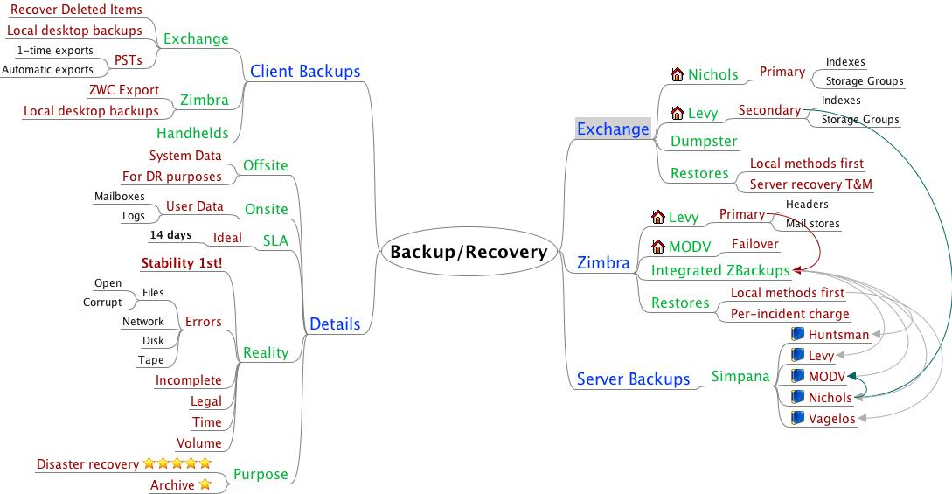
Backups

Slide 25
Exchange 2010
More automatic failover features
Transport resiliency
Smarter about using cheap disk
Outlook Web App
ActiveSync – free/busy lookup, push Outlook updates to Windows handhelds
Notes:
Transport resiliency – shadow copies of messages in case they need to be resent

Slide 26
Q&A – Your topics
Version - Exchange 2007 SP2 Update Rollup 1
Snow Leopard Mail/iCal problems with Exchange, including delegation
Preventing the sending of mail from resource accounts
Near or over quota notices - 9 a.m., noon, or any time other than midnight

Slide 27
References
http://www.upenn.edu/computing/email/
http://www.upenn.edu/computing/email/exchange/sig-meetings/
https://zimbra.upenn.edu/home/nt-dtime/Calendar?fmt=html

Slide 28
Clients and
Mobile Devices

Slide 29
Exchange Clients
Eliminating support for Outlook 2003, Entourage 2004
Outlook 2007 & Entourage 2008 support to be SP2 only
Outlook 2010 works, documentation forthcoming
Entourage users should consider upgrading to EWS

Slide 30
Zimbra Clients
Thunderbird is supported and recommended Zimbra client
Moving forward with transitioning from 2.0.0.x to 3.0.x for FY11
Outlook 2003/SP3, Outlook 2007/SP2, Apple Mail still supported
Outlook 2010 support on the way, still needs ZCO testing

Slide 31
Mobile Devices
Supported platforms:
  BlackBerry OS 4.5+
  iPhone OS 3.x
  webOS 1.2+
  Windows Mobile 6.1+

Slide 32
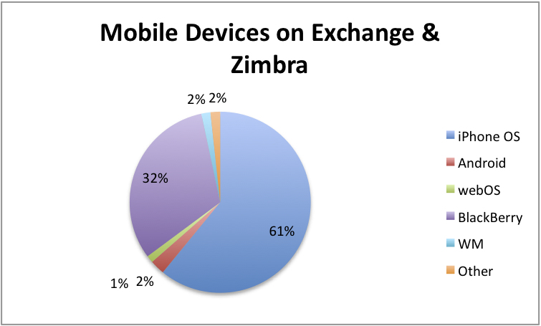
Device Prevalence

Slide 33
iOS 4
Should be available 6/23
Increased Exchange/ActiveSync friendliness
Some security issues
Some reliability issues

Slide 34
Android
2.2 (FroYo) will likely be supported
Brings full ActiveSync connector
Devices not branded "with Google" supported on a device- by- device basis
Still no encryption

Slide 35
Windows Phone 7
Coming this Fall/Winter
Likely to be supported
Not as Exchange-friendly as WM 6.5

Slide 36
Zimbra

Slide 37
Overview
Production on July 26, 2008
10 Linux servers in 2 campus data centers
2.5 TB of mailbox storage
Data replicated in Levy and MODV campus data centers
About 13,450 accounts (down about 1% from FY09)
Almost 200 with Mobile Sync enabled (up 214% over FY09)
About 230 users purchased higher quota (up 16% since Q2)

Slide 38
Service Review
Availability for FY10 YTD
Incidents
Maintenance
Remedy Cases
Accomplishments
Rates

Slide 39
Availability
Target: 99.9% (<9 hours)
Zimbra: 99.97 % (2 hours, 24 minutes)
Will begin tracking BlackBerry
Averaged across multiple servers/services

Slide 40
Incidents
January 4, 2010 - 10:15 - 3:00 p.m. - WebLogin affects ZWC logins
February 10, 2010, 10:10 - 10:45 a.m. - Slow performance in ZWC due to high # of IMAP connections
February 17, 2010 - Periodic slowness, again due to load
March 29, 2010 - Slowness; corrected with tuning
June 14, 2010 - SMTP connectivity errors for Microsoft clients due to certificate issues

Slide 41
Maintenance
January 31, 2010, 12 p.m. - Contact Cleaner Zimlet (non-disruptive)
January 24, 2010, 1:00 - 2:00 a.m. - Upgrade from 5.0.15 to 5.0.21; Mac client, calendaring, ZCO fixes
May 7, 2010 - 5:00 - 6:00 a.m. - Added more disk
June 6, 2010 - 5:00 - 6:00 a.m. - Adding more disk, continues on to ...
June 13, 2010 - 5:00 - 6:00 a.m. - … when work is completed; also, partially disruptive SSL certificate update

Slide 42
Maintenance
As agreed, unadvertised, disruptive maintenance of up to 15 minutes may be performed:
Mon-Fri: 1am-3am
Sat-Sun: 6am-7am

Slide 43
Remedy Cases
SLA: 24 hour response
Over Dec-May, ~17 cases/month; (down 40% from FY09)
Notes:
171 cases in previous period, December 2008 – May 2009

Slide 44
Accomplishments
Winter Feature Release:
Zimbra 5.0.21
Tuning to perform better under very heavy load
BlackBerry for Zimbra

Slide 45
Rates
First change to base price in four years
Enhanced @ $3.10/month (from $3.00) and Basic @ $3.60/month (from $3.50) for FY11
BlackBerry service to line up with Exchange at up to $14.00/month for FY11
Additional storage: $1.25/250MB/month (unchanged)
Quota: 500MB; Auto-quota up to 4GB; Max quota up to 10GB

Slide 46
Zimbra Roadmap
Short-term (0-3 months)
Medium-term (4-12 months)
Long-term (>1 year)

Slide 47
Short-term
Performance monitoring - round trip and delivery delays
Scaling - 2nd Mailbox Server and Kerberos Proxy
Calendering interoperability
Notes:
WFR likely for January.

Slide 48
Medium-term
Zimbra 6.0 - better admin tools, social networking, better mobile UI, filter existing messages, read receipt, three-pane view, enterprise management of handhelds, and more
Unified Communications - Integration opportunities between Zimbra, IM, and/or PennNet Phone
More traction for an XMPP proxy

Slide 49
Long-term
What's going on at VMWare/Zimbra:
Increased headcount; messaging platform for their enterprise; focus on stability and performance over new features
Focus on ZDesktop as Outlook replacement
ZCO that works with Outlook 2010
iPhone 4.0 and iPad support
Remove dependency on ZCB middleware

Slide 50
Q&A - Customers
Some Zimbra bugs we track:
6062 (Kerberos/SSO for CalDAV, web UI) - more votes (53) and comments from others (assigned)
15120 (Calendar templates) - more votes (55) and comments from others (assigned)
19398 (XMPP proxy) - more votes (66) and comments from others (assigned)
20882 (Kerberized ZDesktop) - mostly Penn and Stanford (only 6 votes)
Are there others important to you?

Slide 51
Q&A – Your topics
Roadmap for BlackBerry
Charges for other mobile handhelds

Slide 52
References
http://www.upenn.edu/computing/email/
http://www.upenn.edu/computing/email/zimbra/sig-meetings/
http://prowiki.isc.upenn.edu/wiki/ISC_Zimbra_documentation
https://zimbra.upenn.edu/home/nt-dtime/Calendar?fmt=html

Slide 53
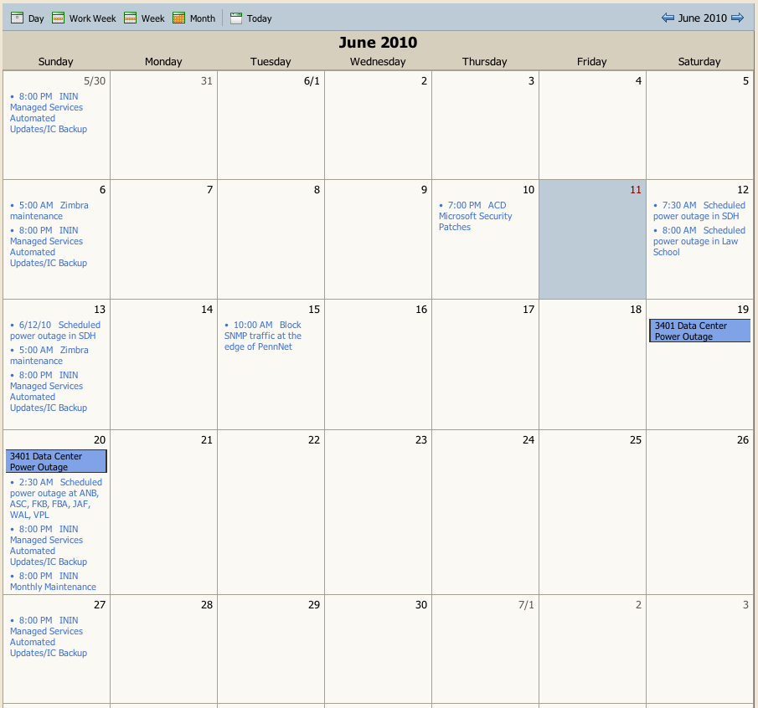
https://zimbra.upenn.edu/home/nt-dtime/Calendar?fmt=html
Notes:
For web display:
https://zimbra.upenn.edu/home/nt-dtime/Calendar?fmt=html
Or subscribe with your iCal compatible calendar client:
https://zimbra.upenn.edu/home/nt-dtime/Calendar

Slide 54
Thank You

